Slide 1
Self-Supervised Learning for End-to-End Particle Reconstruction for the CMS Experiment
Sidharth SS (IISER, Mohali)

Slide 2
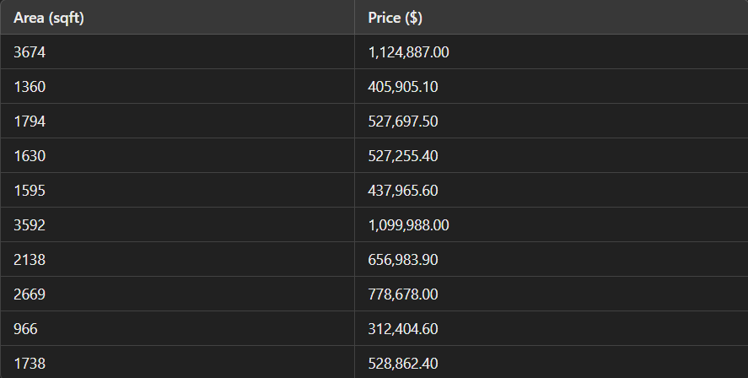
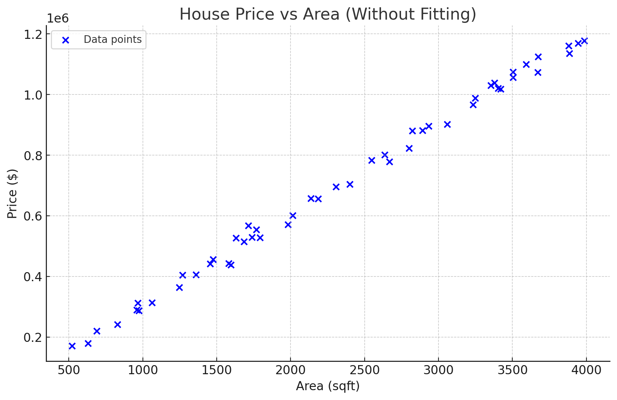
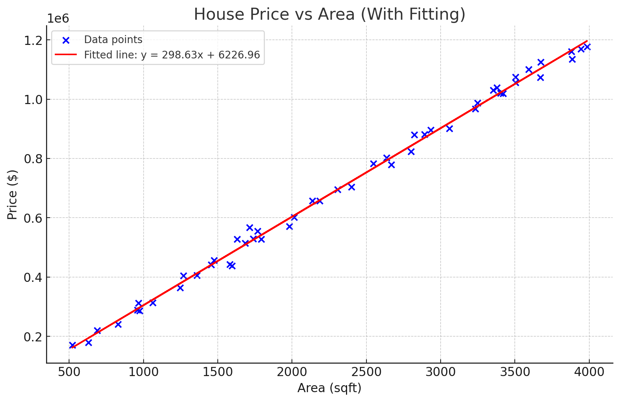
An example problem!

Slide 3
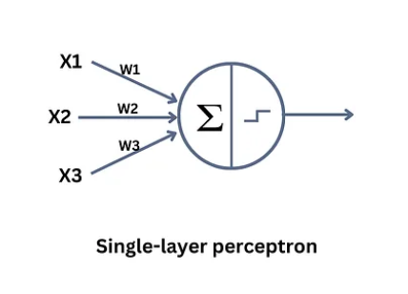
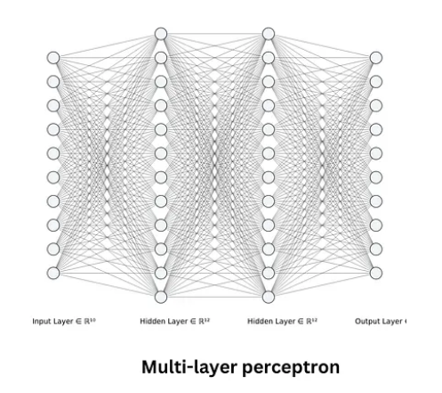
The Perceptron model

Slide 4
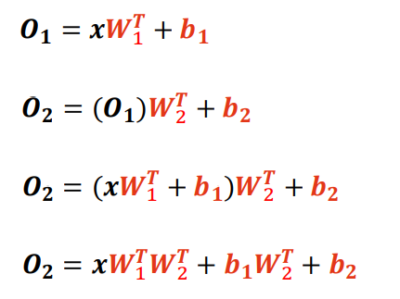
Why do we need activation functions?
After each Linear layer, we usually apply a nonlinear activation function. Why?

Slide 5
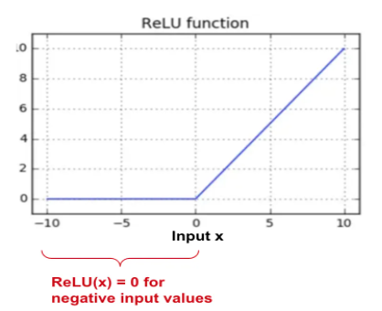
What Happens in an Activation Function?
Purpose: Adds non-linearity, enabling neural networks to model complex patterns.

Slide 6
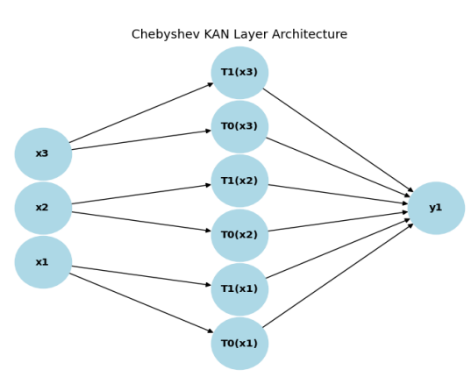

Architecture of Chebyshev KAN
Structure Overview:
Input features are transformed into Chebyshev polynomials (polynomial tensor).
Learnable coefficients on edges adjust polynomial terms for optimal approximation.

Slide 7
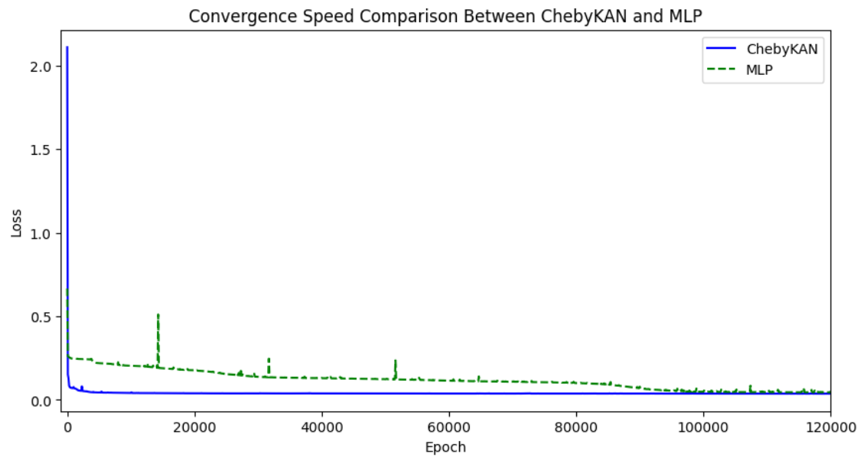
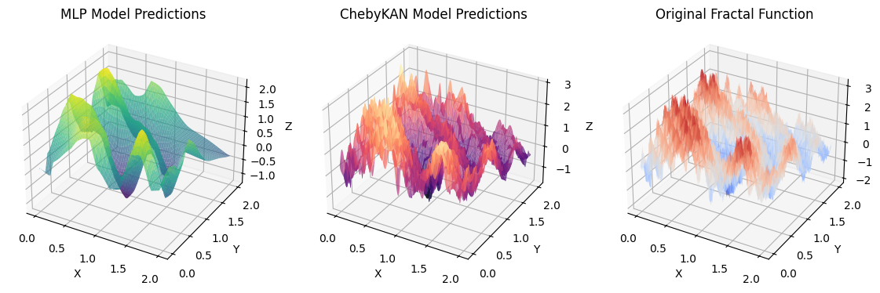
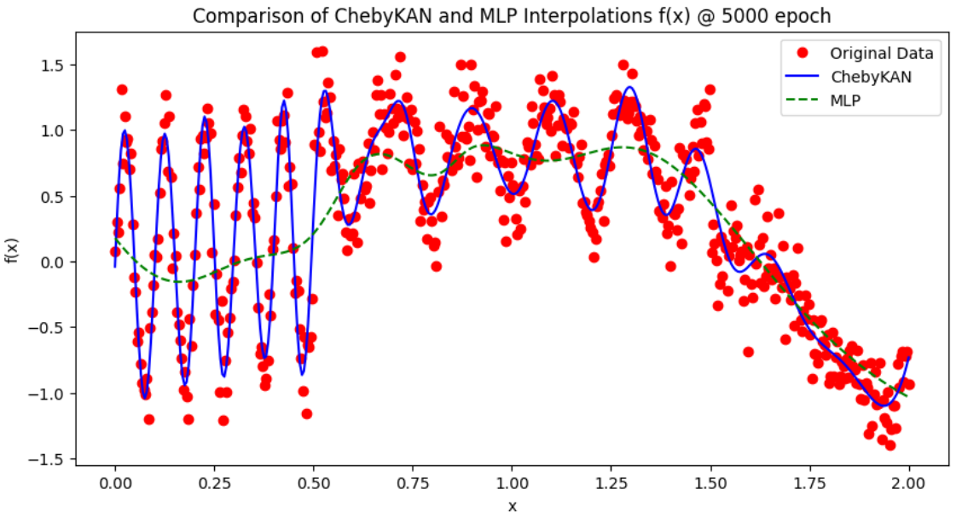
Why KAN?

Slide 8
SSL for E2E Particle Reconstruction
Project Background:
CMS experiment at CERN’s LHC seeks new physics by reconstructing particles and event topologies from collision data.
Traditional models rely on labeled data, but SSL leverages unlabeled data, enabling feature learning without direct supervision.
Goal:
Develop a deep learning pipeline for particle reconstruction using advanced SSL methods, more specifically tailored for high-dimensional data from LHC collisions
Comparison between KAN and MLP
Experimental Setup: Both models were designed with a similar number of parameters to ensure a fair comparison.

Slide 9
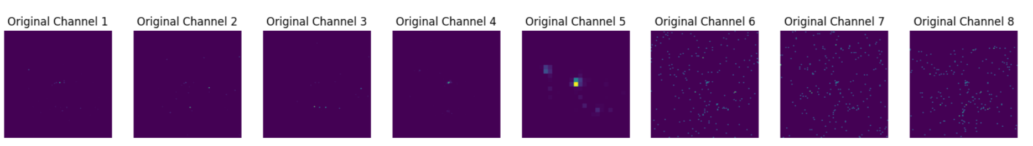
Dataset
The dataset comprises several million unlabelled samples and contains eight channels (Transverse momentum, dz, Track Information, and ECAL and HCAL projection). The dataset additionally contains some basic information regarding the experimental setup (iɸ and iΘ).

Slide 10
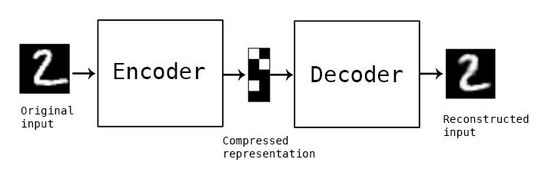
Autoencoder
Role: Learns a compressed representation of high-dimensional particle data for efficient reconstruction.

Slide 11
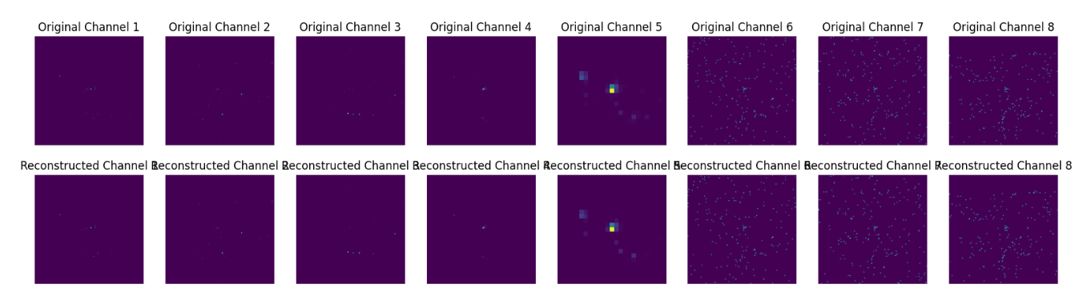
Autoencoder
Original v/s reconstructed channels

Slide 12
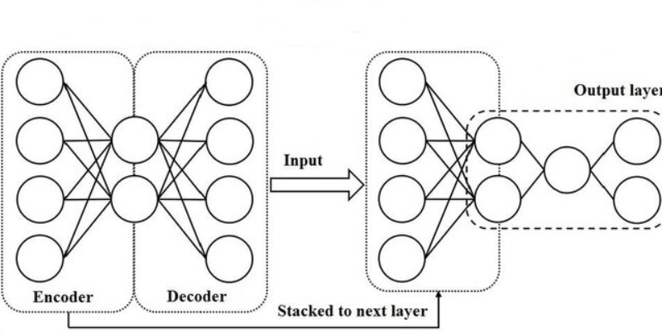
Fine-Tuning
Approach: Freeze the encoder parameters of the pre-trained model to retain learned features.
Integration: Combine the frozen encoder with a binary classifier head to classify particle events.

Slide 13
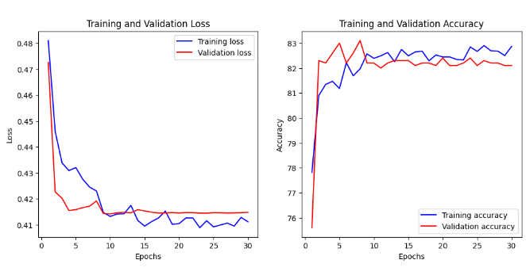
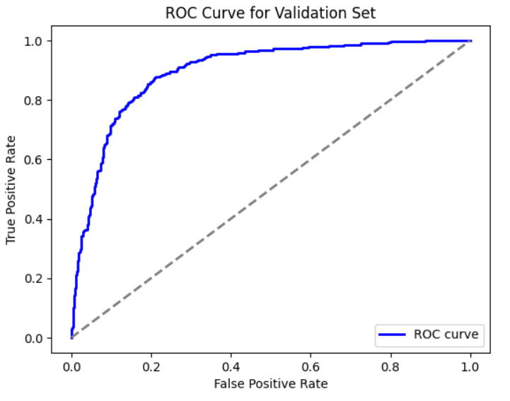
Training Curves for KAN-Based Model
Train Loss: 0.4111, Train Accuracy: 82.87%
Val Loss: 0.4148, Val Accuracy: 82.10%
Train ROC AUC: 0.9007, Val ROC AUC: 0.8972

Slide 14
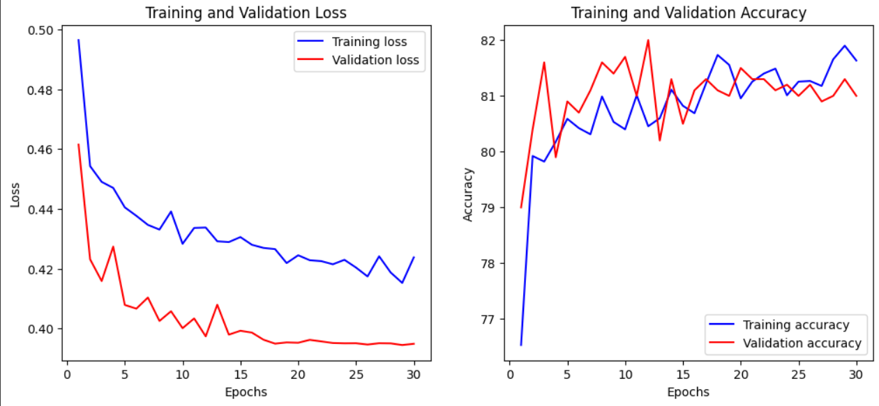
Training Curves for MLP-Based Model
Train Loss: 0.4238, Train Accuracy: 81.63%
Val Loss: 0.3949, Val Accuracy: 81.00%

Slide 15
Conclusion & Future work
Findings:
The KAN model outperformed the MLP in accuracy for particle reconstruction.
KAN is harder to train due to sensitivity to hyperparameter tuning.
KAN takes more training time than MLP, but this can be optimized with better engineering.
Conclusion:
KAN can be used as an alternative to MLP, even for very high-dimensional data, due to its superior accuracy in complex tasks.
Training challenges with KAN can be addressed through hyperparameter optimization and efficient computation techniques.
Future work: Improve training stability, explore ViT models, and optimize training pipelines to reduce time and resource consumption.

Slide 16
Thank You!

